Slide 1
Hydrogen Injection in Natural Gas Pipelines
Parametric CFD Study: Effect of Injection Angle and Side on Mixing Quality and Pressure Drop
Yash Sakhare | 2022CH71496 | CLD 880 Minor Project Supervisor: Prof. Abhijeet Raj | Department of Chemical Engineering, IIT Delhi
40 simulations · 4 campaigns · rhoReactingBuoyantFoam + k-ω SST

Slide 2
Problem Statement & Objectives
▸ Hydrogen blending into high-pressure CH₄ pipelines requires uniform mixing
to avoid combustion hazards and metering errors (target: CoV ≤ 0.05)
▸ Key question: How do injection angle (30° vs 90°) and injection side
(top vs bottom) affect mixing quality and pumping cost?
▸ Parametric study: 4 campaigns × 10 Latin-Hypercube-sampled cases
varying d/D (0.20–0.45) and VR (0.7–5.8) at fixed Re_D
▸ Solver: rhoReactingBuoyantFoam (compressible, buoyant, multispecies)
with k-ω SST turbulence, half-domain symmetry, adaptive time-stepping

Slide 3
Campaign Overview: 40 Valid Cases
Campaign Valid Cases CoV median CoV range |ΔP| median (kPa)
90° top 8 0.424 0.066 – 0.707 1.05
30° top 9 0.298 0.005 – 0.390 0.53
90° bottom 13 0.392 0.172 – 1.104 1.58
30° bottom 10 1.048 0.232 – 1.343 1.02
▸ CoV = σ(Y_H2)/⟨Y_H2⟩ at outlet (area-weighted). Lower = better mixing.
▸ |ΔP| = LP-filtered (moving-average, 0.10s width, mean on [0.4, 1.2]s window).
▸ Excluded: 90° top cases 01–02 (mesh defect), 30° top case 04 (incomplete).

Slide 4
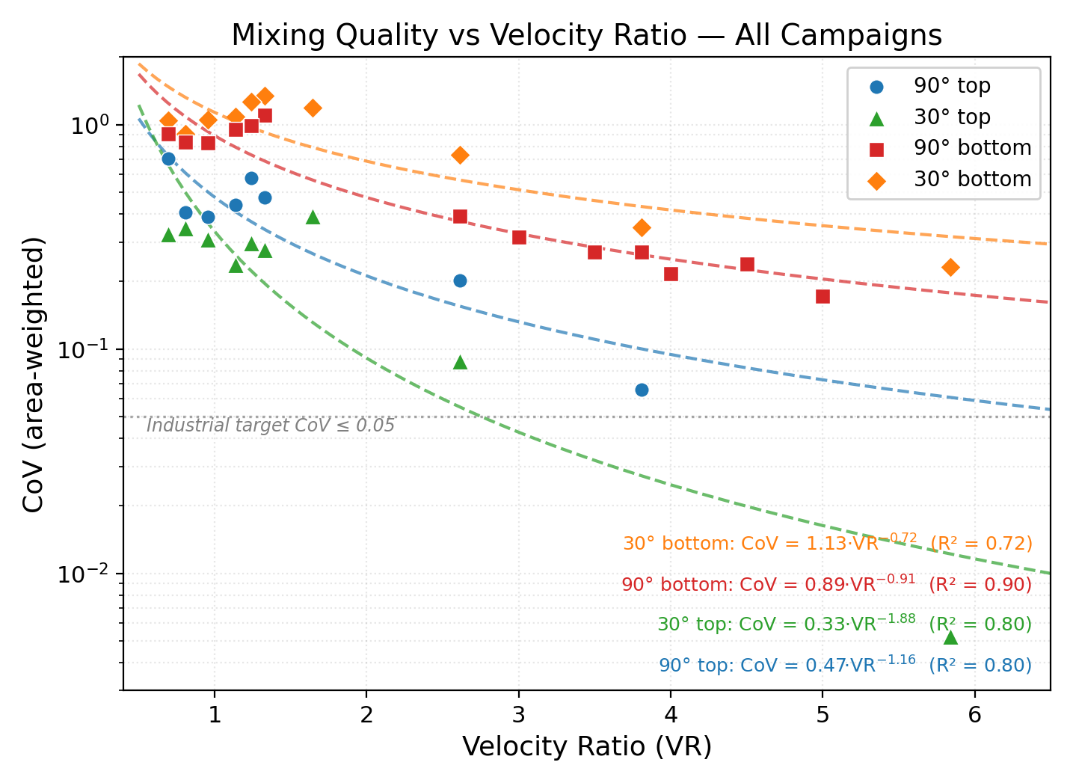
Mixing Quality vs Velocity Ratio
▸ VR is the dominant control
variable across ALL campaigns
▸ Power-law fit CoV = A·VR^b:
90° top: b = −1.16 (R²=0.80)
30° top: b = −1.88 (R²=0.80)
90° bot: b = −0.91 (R²=0.90)
30° bot: b = −0.72 (R²=0.72)
▸ Top injection has steeper
exponents → VR buys more
mixing from the top
▸ Only 30° top reaches the
industrial CoV ≤ 0.05 target

Slide 5
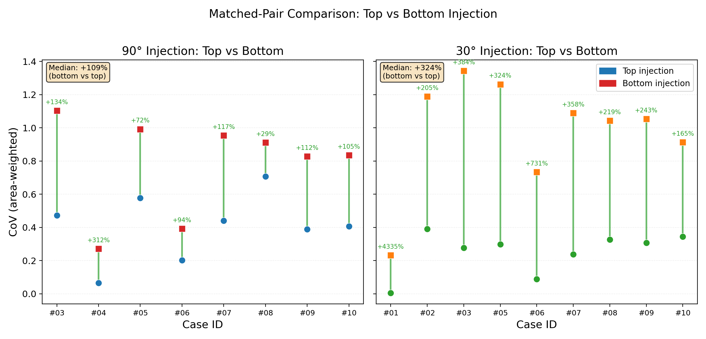
Top vs Bottom: Matched-Pair Comparison
▸ 17 matched pairs (same d/D, VR)
▸ Top wins in ALL 17 pairs
(p = 2⁻¹⁷ = 1.5×10⁻⁵)
▸ 90°: median +109% CoV
(bottom mixes ~2× worse)
▸ 30°: median +324% CoV
(bottom mixes ~4× worse)
▸ Bottom injection is strictly
dominated at every point

Slide 6
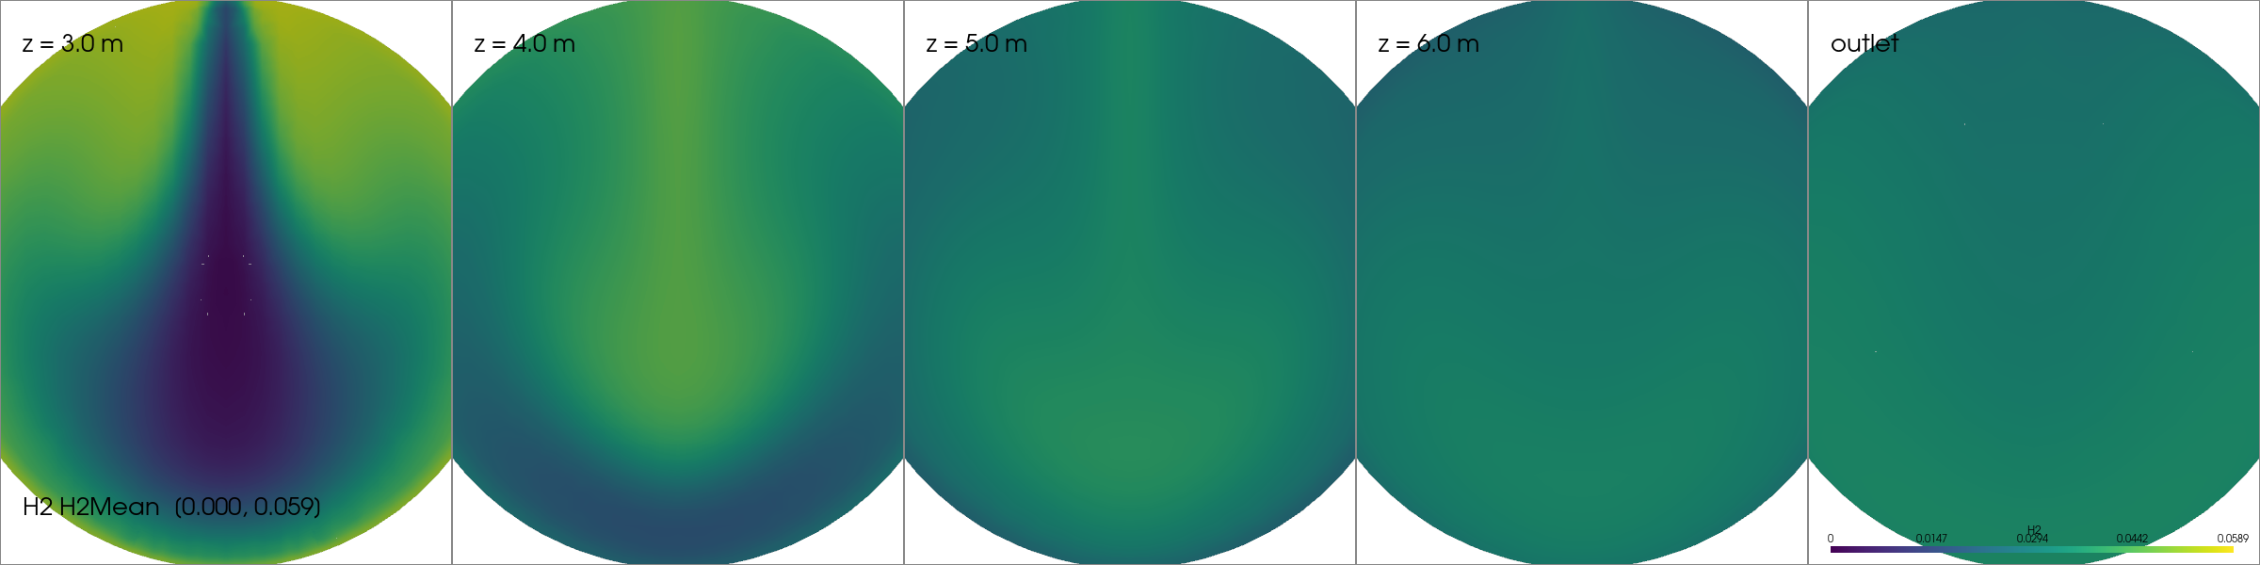
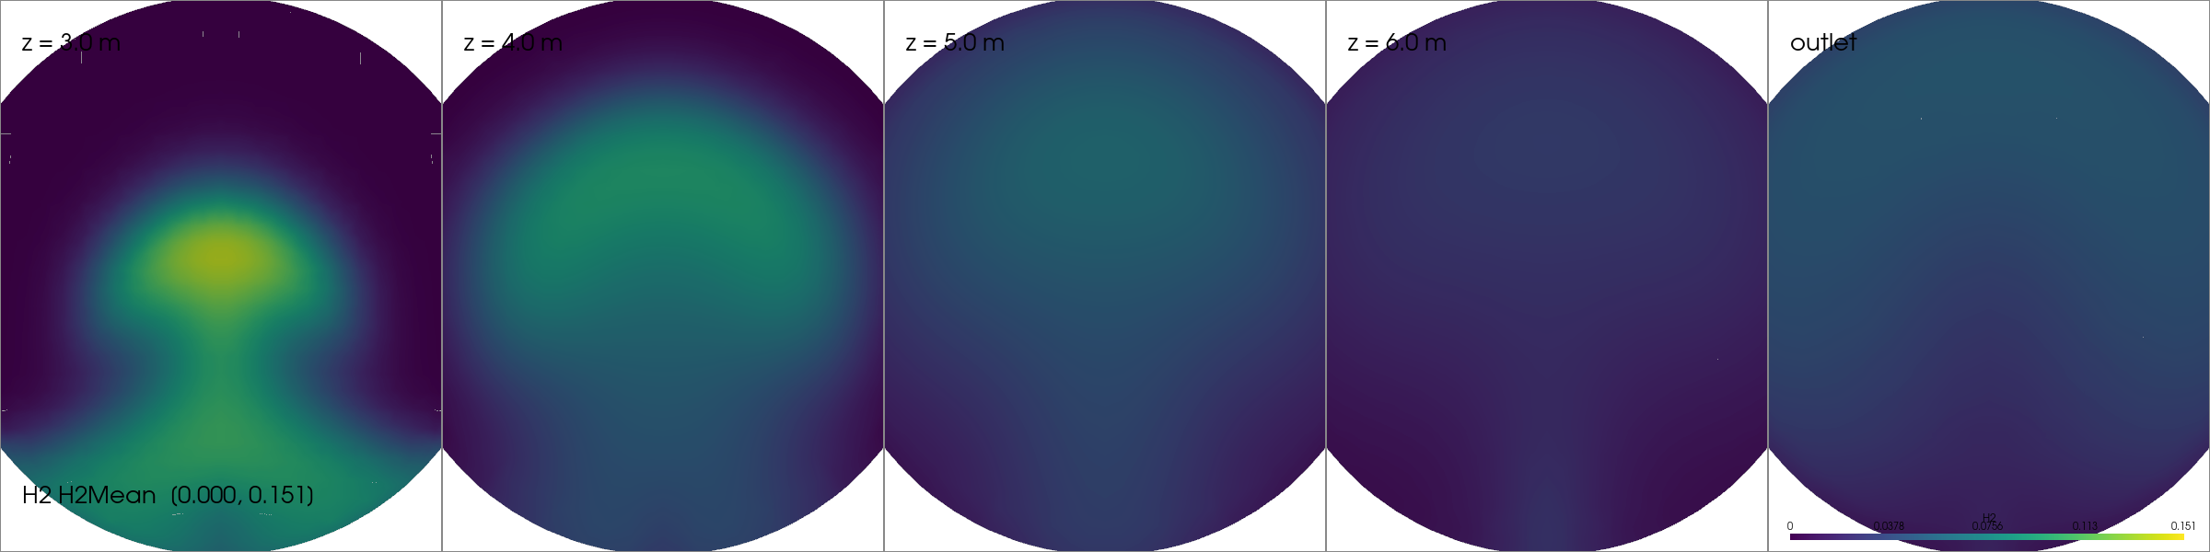
Visual Evidence: Case 04 (d/D=0.252, VR=3.81, 90°)
TOP injection — CoV = 0.066
BOTTOM injection — CoV = 0.271
Top: jet spreads laterally → uniform by z = 5m. Bottom: coherent mushroom plume → concentration gradient persists.

Slide 7
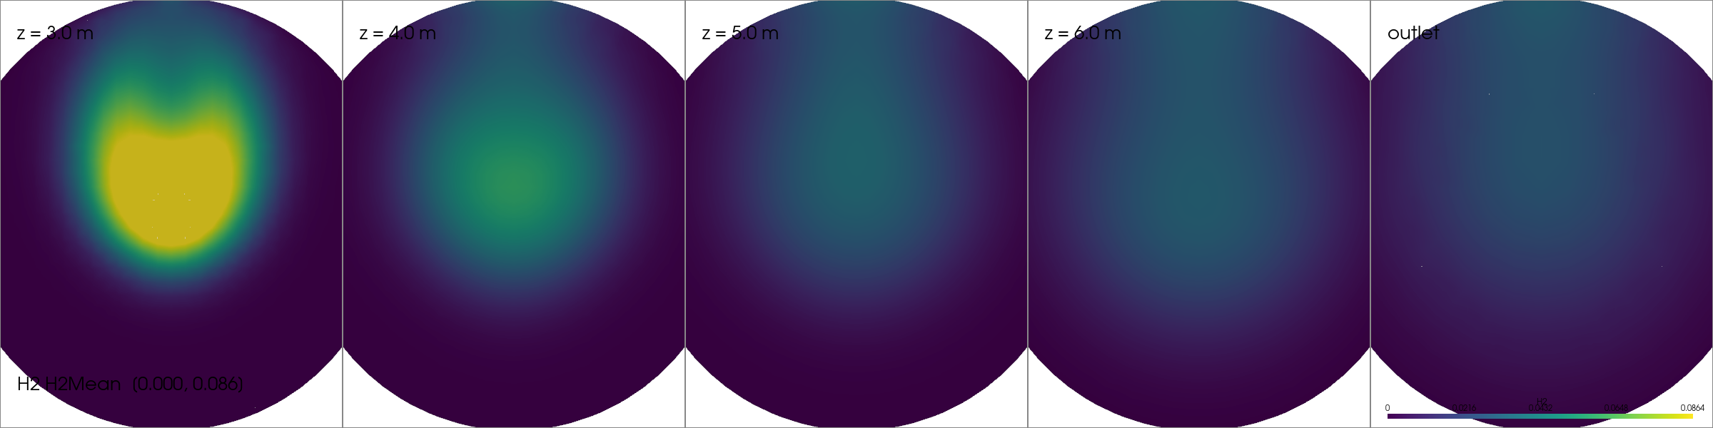
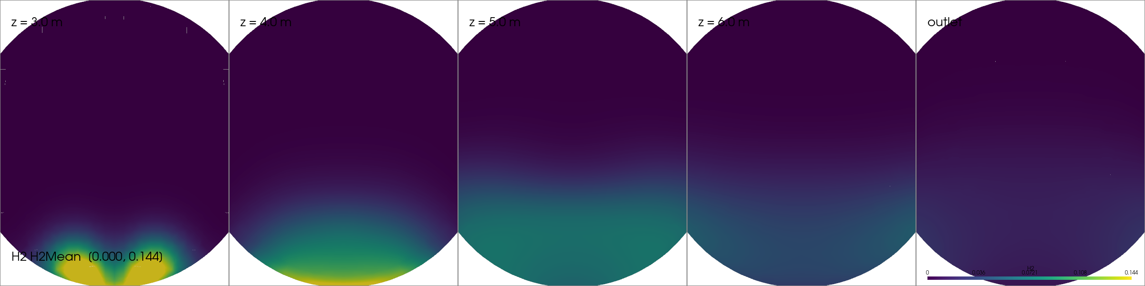
Visual Evidence: Case 08 (d/D=0.382, VR=0.69, 90°)
TOP injection — CoV = 0.707
BOTTOM injection — CoV = 0.911
Low VR: neither mixes well, but bottom creates buoyancy-driven stratification (two-layer structure at outlet).

Slide 8
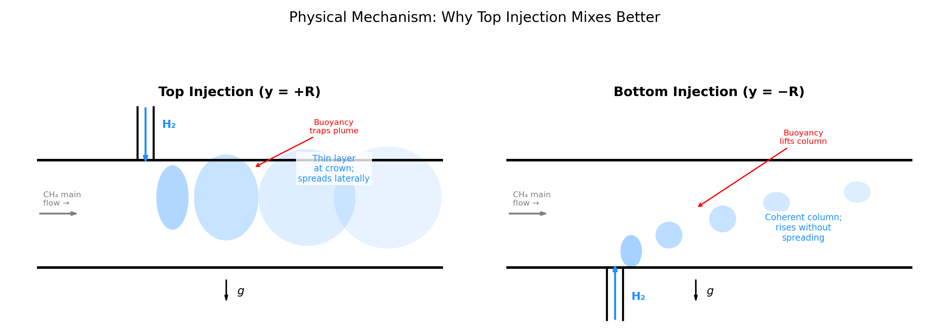
Physical Mechanism: Why Top Injection Wins
▸ Top: buoyancy OPPOSES the jet → plume flattens at crown → large interfacial area → rapid diffusion
▸ Bottom: buoyancy ASSISTS the jet → plume rises as coherent column → small area → poor diffusion
▸ Consistent with Ri-based stratification physics: at Ri >> 1, buoyancy suppresses lateral spreading

Slide 9
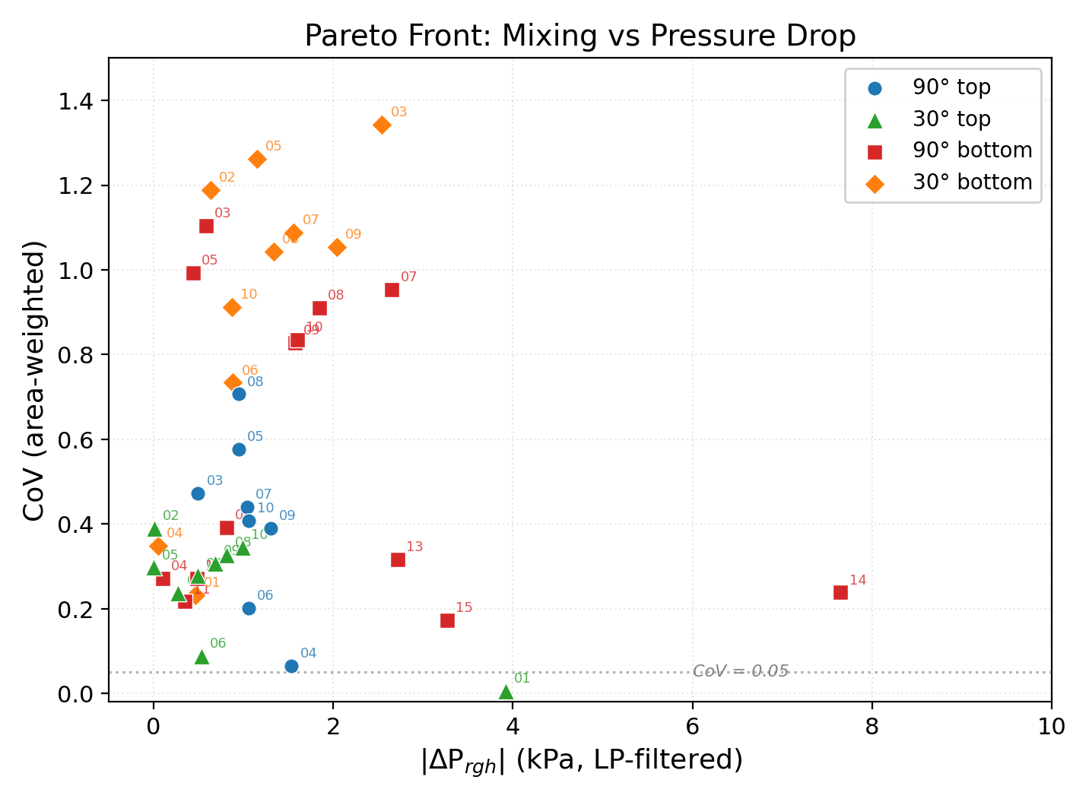
Pareto Front: Mixing vs Pressure Drop
▸ Lower-left = simultaneously
cheap and well-mixed
▸ Top-injection points cluster
in the desirable region
▸ Bottom-injection points shift
upward (worse mixing) with
no leftward shift (no ΔP
benefit)
▸ No bottom-injection case
reaches CoV ≤ 0.05
▸ 30° top dominates the front

Slide 10
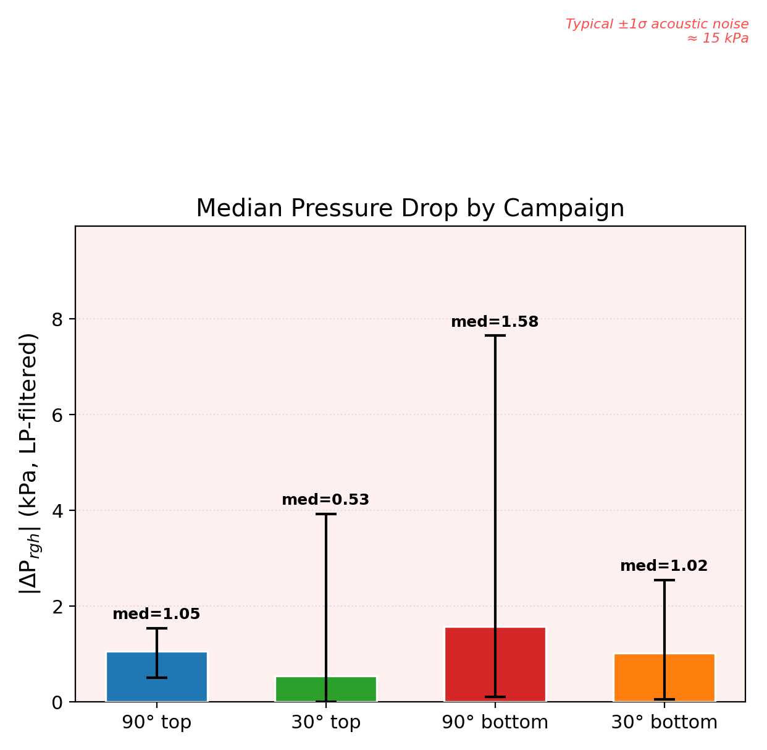
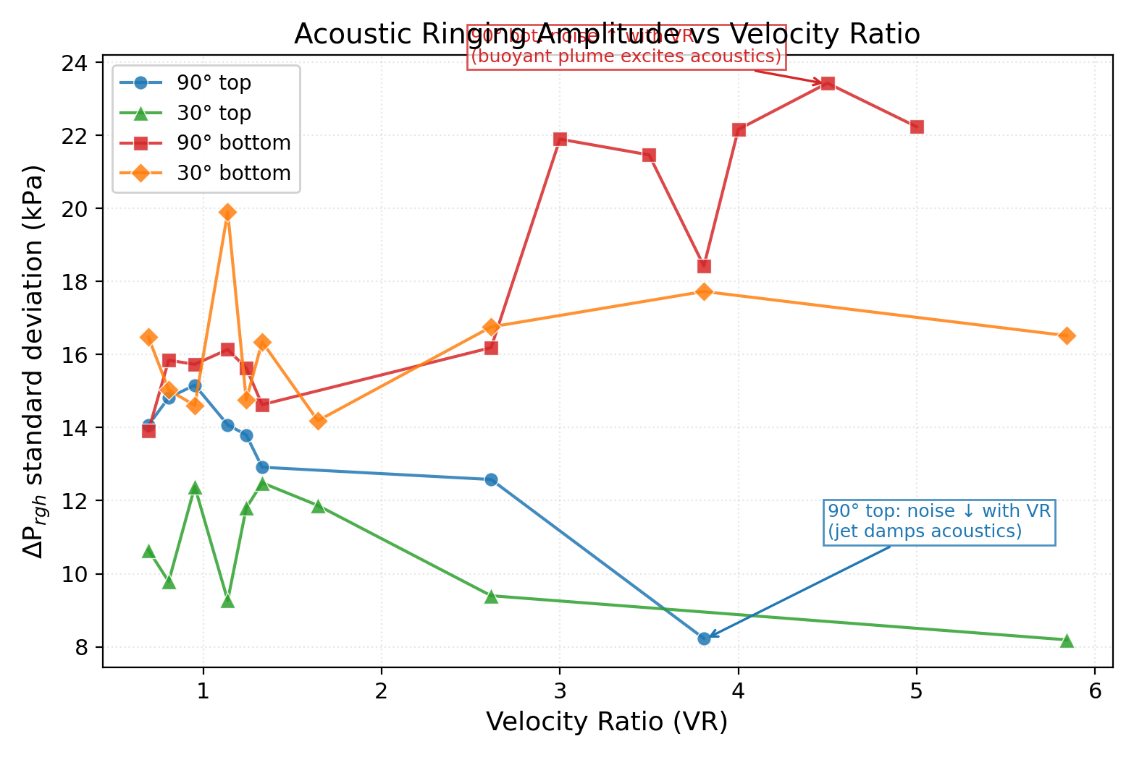
Pressure Drop: Not a Differentiator
▸ All 4 medians within ~1 kPa — ΔP is not the differentiator
▸ 30° tilt reduces ΔP by ~50% (classical turning-loss reduction, Idelchik)
▸ Acoustic noise: top-injection → quieter at high VR (well-mixed pipe); bottom → louder (density gradients scatter waves)

Slide 11
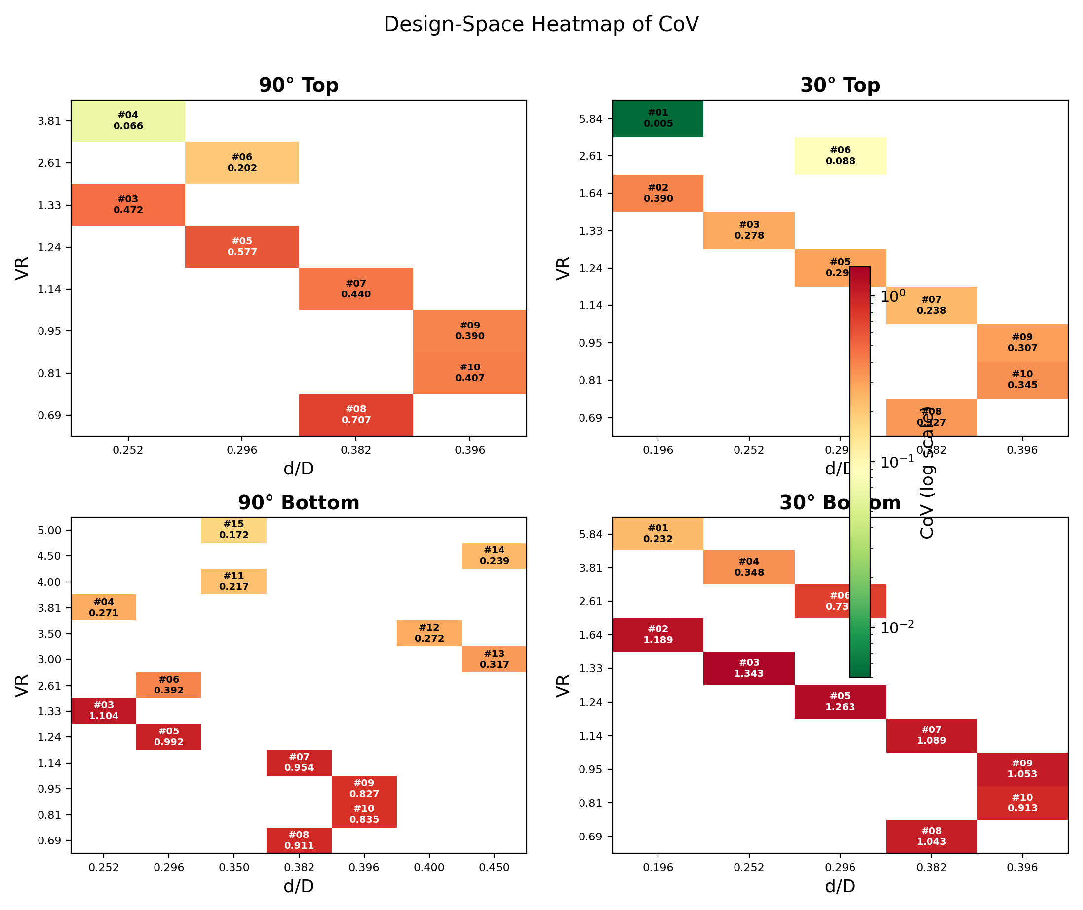
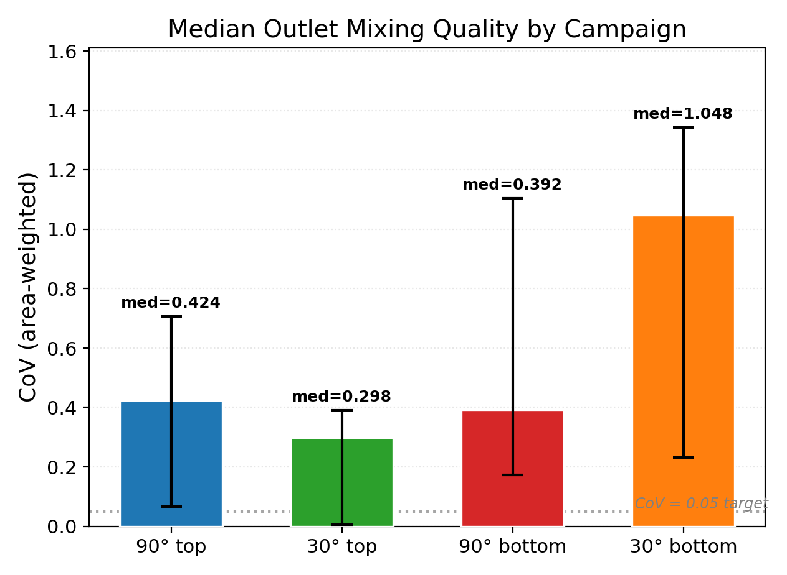
Design-Space Heatmap & Executive Summary
▸ Bottom row uniformly darker (worse) than top row at every (d/D, VR)
▸ 30° top: best median (0.298); 30° bottom: worst (1.048)
▸ d/D effect is secondary: larger d/D mildly improves mixing (consistent with Su et al. 2022)

Slide 12
Conclusions & Practical Recommendations
1. Always inject from the TOP, not the bottom.
→ Bottom injection degrades CoV by 2–4× at every matched point,
with no pressure-drop benefit.
2. Use a tilted branch (30°) rather than 90° for top injection.
→ 30° top: best mixing (CoV = 0.005) and lowest ΔP (50% less than 90°).
3. Maximise velocity ratio (VR ≥ 2.5).
→ VR is the single strongest lever; CoV ~ VR^(−1.2 to −1.9) for top injection.
4. d/D is a secondary parameter (0.20–0.45 range).
→ Matters mainly through coupling with VR via the HBR constraint.
5. Physical mechanism validated by acoustic noise correlation:
→ Well-mixed pipes are acoustically quiet (σ_ΔP drops with VR for top injection).

Slide 13
Outlook & Future Work
▸ Re-fit surrogate-MOO (neural network + NSGA-II) on the full 40-case
4-campaign dataset for a (d/D, VR, α, side) Pareto front
▸ Helical static mixer downstream of 30° top best-case to test whether
a compact mixing length (< 5D) is achievable at low ΔP penalty
▸ Extend to steady RANS (rhoSimpleFoam) or longer transients (~5s) to
reduce LP-filter uncertainty from ±0.5 kPa to ±0.05 kPa
▸ Validate at higher Re_D (u_main = 15 m/s, industrial gas pipeline velocity)
All code, data, and figures available at:
github.com/Yash04dsr/CFD-Setup-instructions

